Slide 1
Prompts & Customizations
Ebru Cucen

Slide 2

Relationship with Computers
Terminal
Console application
Notes:
Console Application: compiled windows executable which is working in/out streams and (usually) do not have any graphical interface.
---cmd.exe, powershell.exe, sh.exe, dism.exe, java.exe, phyton.exe, telnet.exe
They run in terminals –they accept user input send to application input stream, read application output and display in its own window as text. Can be local or remote.
---Conhost.exe, ConEmu, ConsoleZ, minty, Putty, KiTTy, Xshell

Slide 3
Windows World
cmd.exe
Terminal
Console application
Powershell.exe
telnet.exe
Notes:
Console Application: compiled windows executable which is working in/out streams and (usually) do not have any graphical interface.
---cmd.exe, powershell.exe, sh.exe, dism.exe, java.exe, phyton.exe, telnet.exe
They run in terminals –they accept user input send to application input stream, read application output and display in its own window as text. Can be local or remote.
---Conhost.exe, ConEmu, ConsoleZ, minty, Putty, KiTTy, Xshell

Slide 4
Windows World
Conhost.exe
cmd.exe
Terminal
Console application
Powershell.exe
ConEmu
telnet.exe
PuTTY
ConsoleZ
Notes:
Console Application: compiled windows executable which is working in/out streams and (usually) do not have any graphical interface.
---cmd.exe, powershell.exe, sh.exe, dism.exe, java.exe, phyton.exe, telnet.exe
They run in terminals –they accept user input send to application input stream, read application output and display in its own window as text. Can be local or remote.
---Conhost.exe, ConEmu, ConsoleZ, minty, Putty, KiTTy, Xshell

Slide 5
Windows World
Conhost.exe
cmd.exe
Terminal
Console application
Powershell.exe
ConEmu
telnet.exe
PuTTY
ConsoleZ
Notes:
Console Application: compiled windows executable which is working in/out streams and (usually) do not have any graphical interface.
---cmd.exe, powershell.exe, sh.exe, dism.exe, java.exe, phyton.exe, telnet.exe
They run in terminals –they accept user input send to application input stream, read application output and display in its own window as text. Can be local or remote.
---Conhost.exe, ConEmu, ConsoleZ, minty, Putty, KiTTy, Xshell

Slide 6
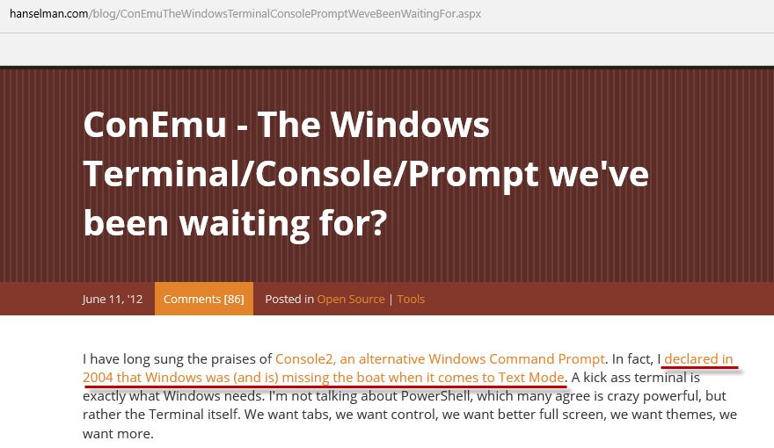

Slide 7
Agenda
Install Choco, ConEmu, Posh-Git
ConEmu Features
Setup Git
Customizing Profile Settings

Slide 8
Install Basics - Demo
powershell -NoProfile -ExecutionPolicy Unrestricted -Command "iex ((new-object net.webclient).DownloadString('https://conemu.github.io/install.ps1'))"
powershell -NoProfile -ExecutionPolicy Unrestricted -Command "iex ((new-object net.webclient).DownloadString('https://conemu.github.io/install.ps1'))"
powershell -NoProfile -ExecutionPolicy Unrestricted -Command "iex ((new-object net.webclient).DownloadString('https://conemu.github.io/install.ps1'))"
Step1 of:
https://github.com/ebrucucen/ConEmuDemo/blob/master/DemoScripts.ps1
*Added Run as Admin to the script

Slide 9
ConEmu
Tabs
Quake Style
Full Screen
Jump list
Inside/Context Menu
Status Bar
ANSI Escape Character
Notes:
Quake mode: console sticks on the top and slides down

Slide 10
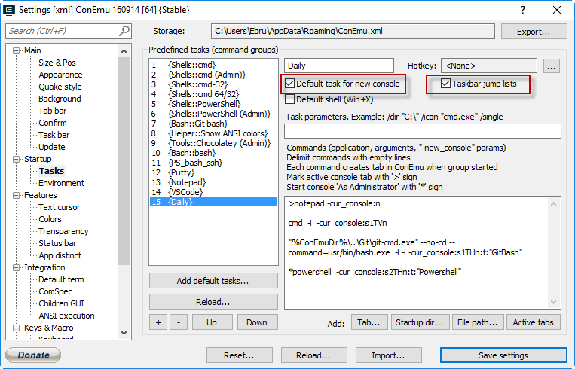
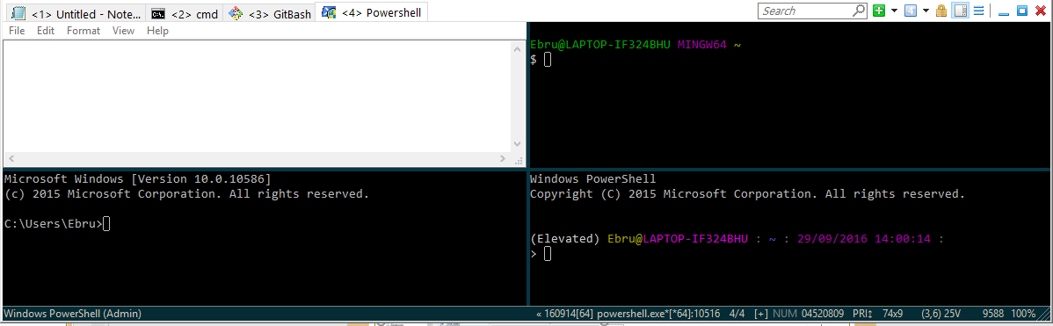
Tabs/Splits

Slide 11
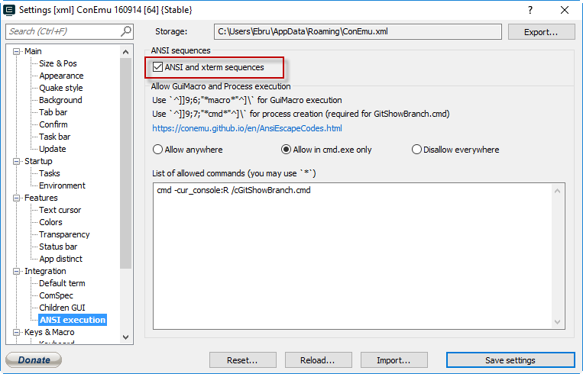
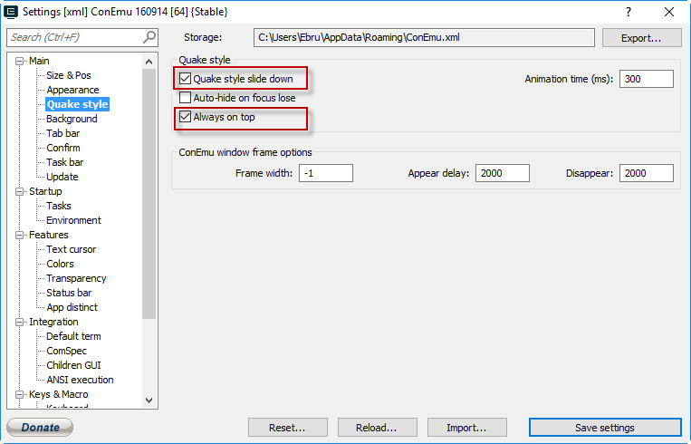
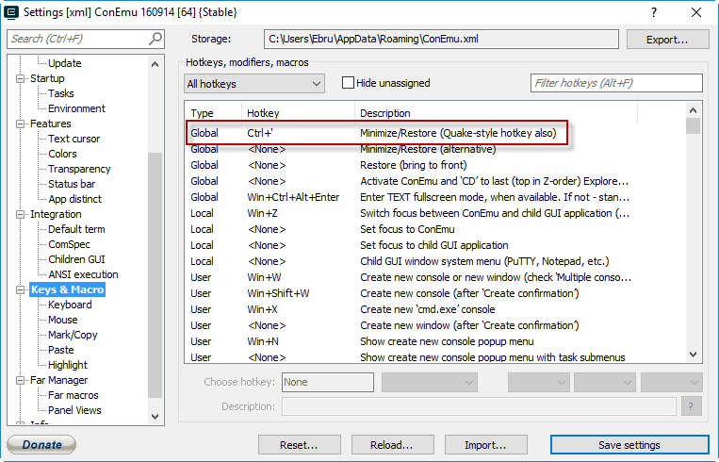
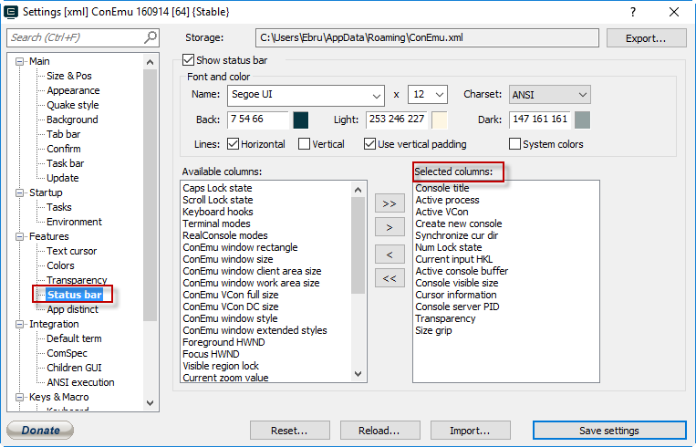
ANSI Sequences

Slide 13
Github Integration
Step 2 of
https://github.com/ebrucucen/ConEmuDemo/blob/master/DemoScripts.ps1

Slide 14
References
http://conemu.github.io/
https://github.com/joonro/Get-ChildItem-Color
https://hodgkins.io/ultimate-powershell-prompt-and-git-setup
https://github.com/dahlbyk/posh-git/blob/master/GitPrompt.ps1

Slide 15
Questions?

Slide 16
Thank you!
If you have not joined:
On Slack : get-psuguk.slack.com
To join [https://get-psuguk.herokuapp.com/]

